Slide 1
Feedback API

Slide 2
Feedback API
General idea
Composition over smaller entities
chaining (higher order) operators as is done in Rx

Slide 3
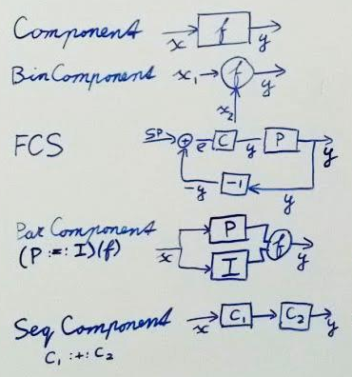
Feedback API
Basic operations
Sequential composition
Parallel composition
Merging two streams
Feedback

Slide 4
Feedback API
Basic operations
Sequential composition
Parallel composition
Merging two streams
Feedback

Slide 5
Feedback API
Basic operations
Sequential composition
Parallel composition
Merging two streams
Feedback

Slide 6
Feedback API
Basic operations
Sequential composition
Parallel composition
Merging two streams
Feedback

Slide 7
Feedback API
Basic operations
Sequential composition
Parallel composition
Merging two streams
Feedback

Slide 8
Feedback API
Last year: first version
Based on derivation of Mealy Machine

Slide 9
Feedback API
Last year: first version
Based on derivation of Mealy Machine
Now: second version
Based on paper by Ross Paterson

Slide 10
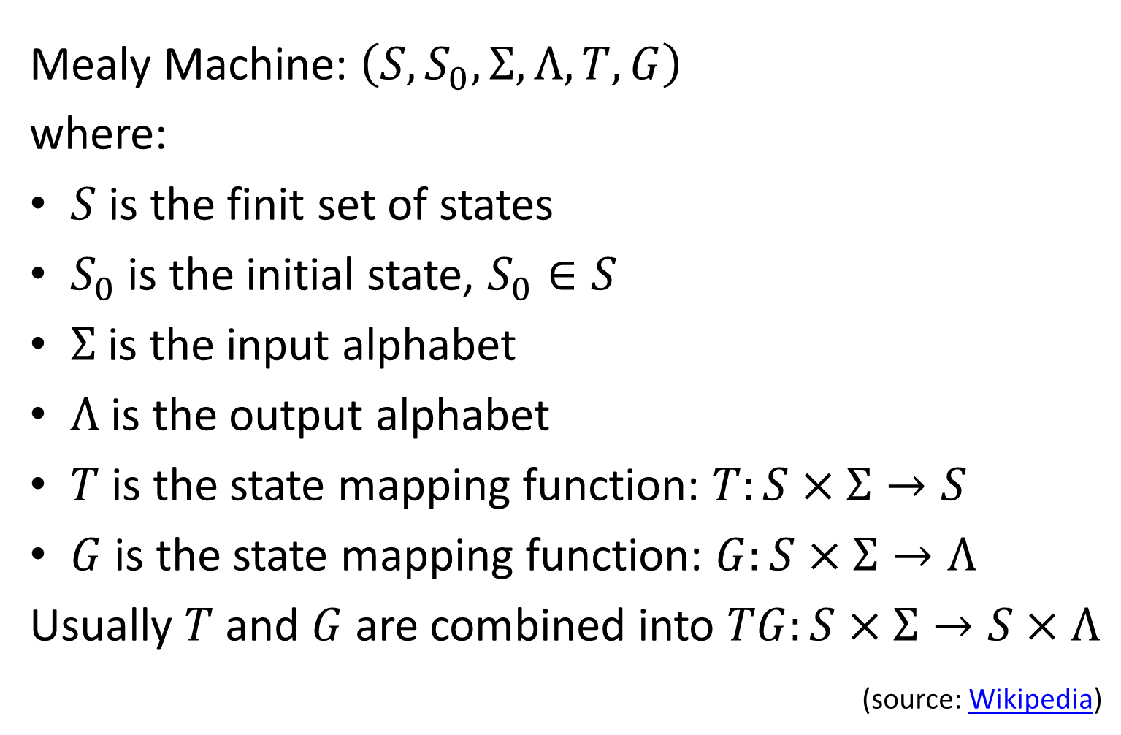
Derivation Component interface
Mealy Machine: $\left(S,S_{0},Σ,Λ,T,G\right)$
where:
$S$ is the finit set of states
$S_{0}$ is the initial state, $S_{0}∈S$
$Σ$ is the input alphabet
$Λ$ is the output alphabet
$T$ is the state mapping function: $T:S×Σ→S$
$G$ is the state mapping function: $G:S×Σ→Λ$
Usually $T$ and $G$ are combined into $TG:S×Σ→S×Λ$
(source: Wikipedia)

Slide 11

Derivation Component interface
$TG:S×Σ→S×Λ$

Slide 12

Derivation Component interface
$TG:S×Σ→S×Λ$
// written in Scala style
type Component = S => I => (S, O)

Slide 13
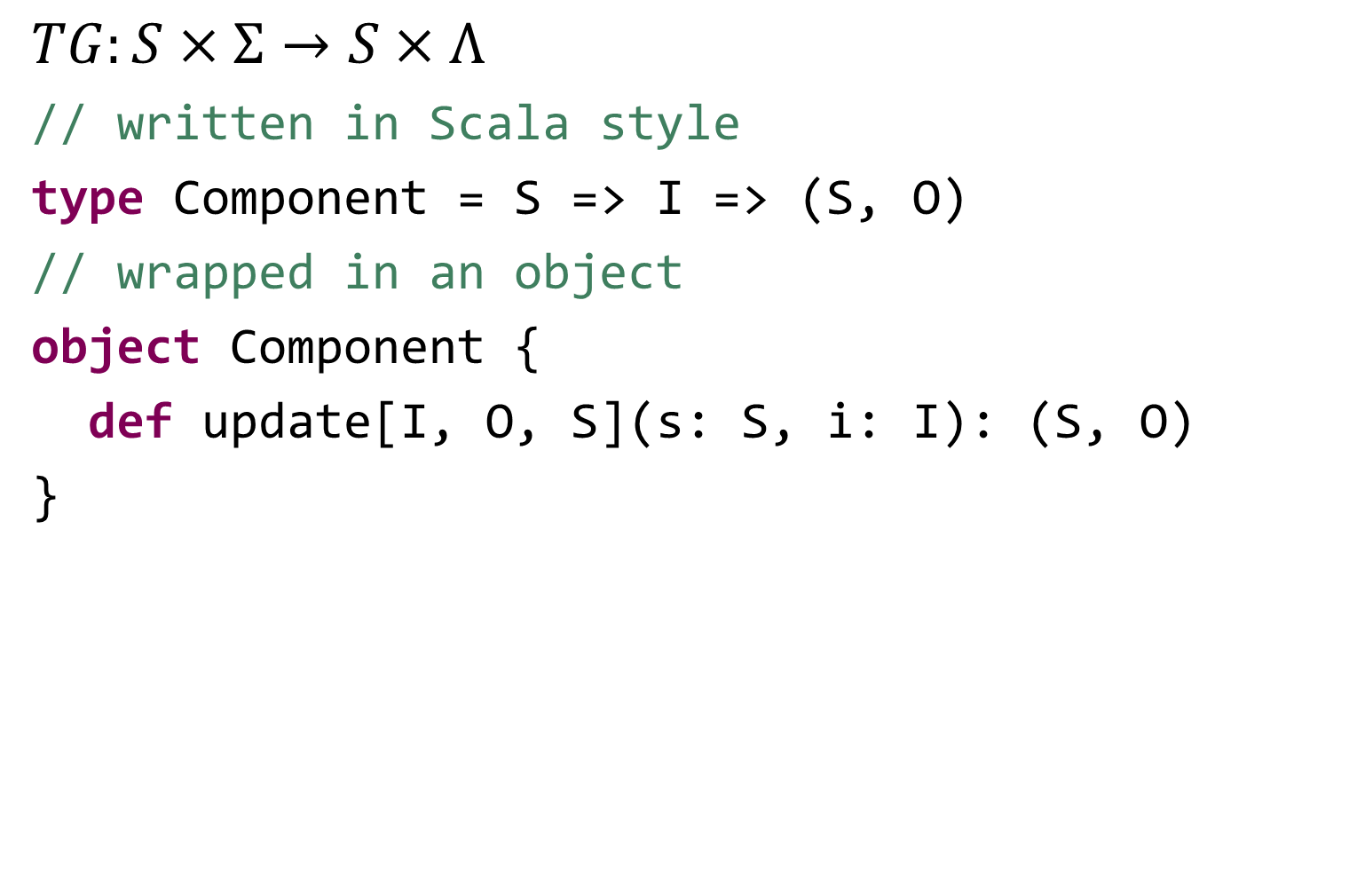
Derivation Component interface
$TG:S×Σ→S×Λ$
// written in Scala style
type Component = S => I => (S, O)
// wrapped in an object
object Component {
def update[I, O, S](s: S, i: I): (S, O)
}

Slide 14
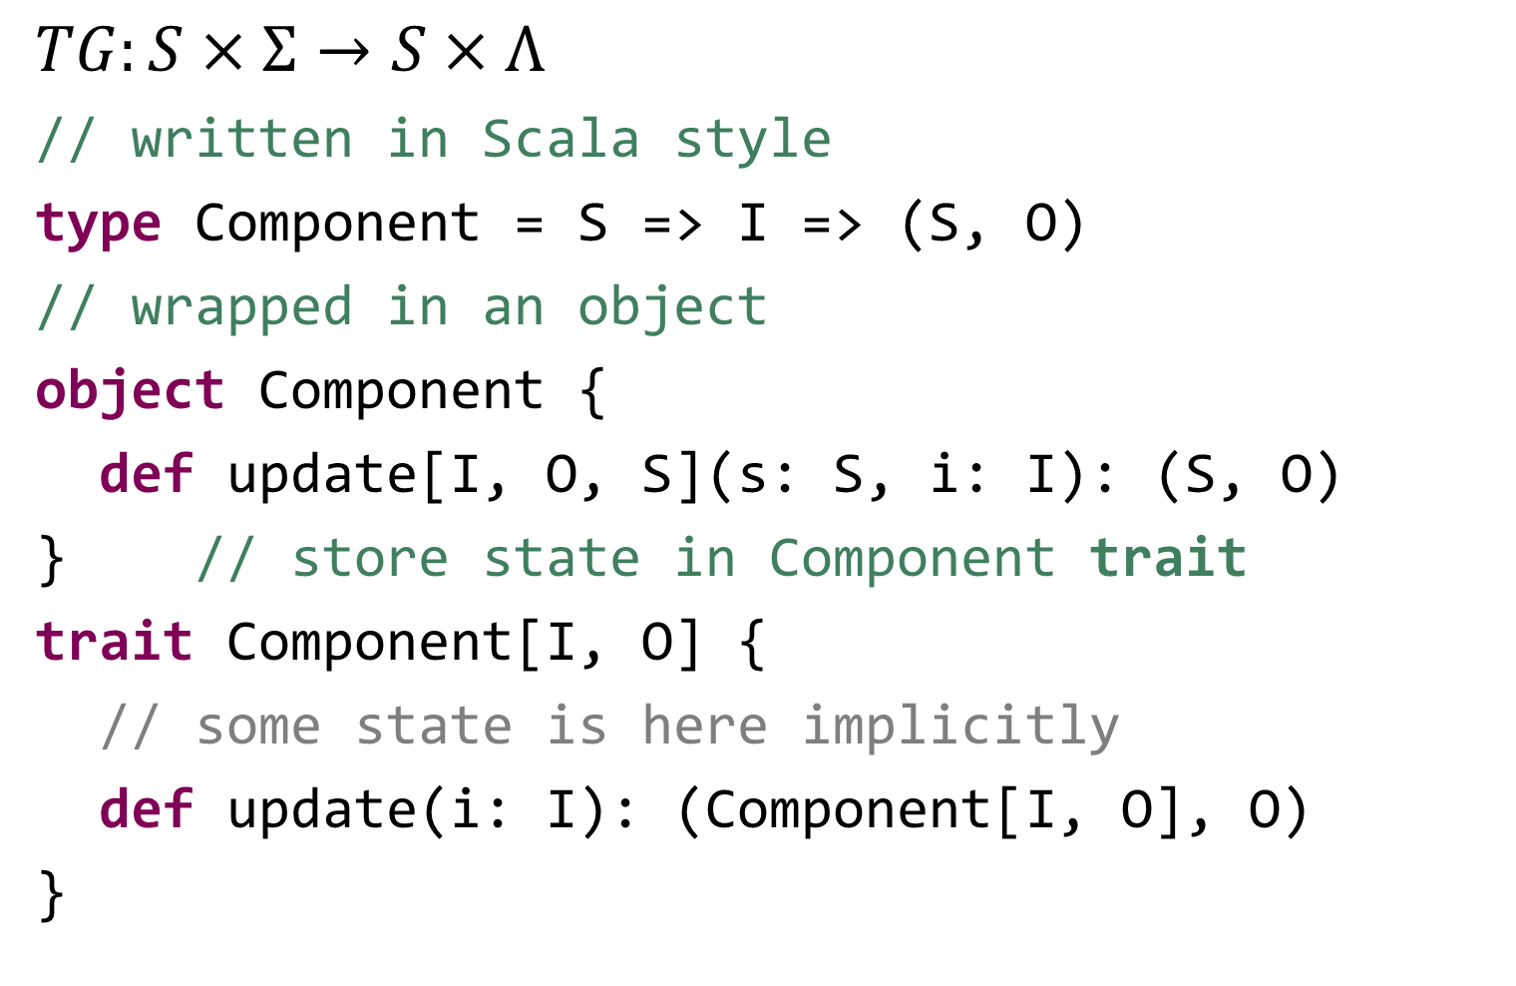
Derivation Component interface
$TG:S×Σ→S×Λ$
// written in Scala style
type Component = S => I => (S, O)
// wrapped in an object
object Component {
def update[I, O, S](s: S, i: I): (S, O)
} // store state in Component trait
trait Component[I, O] {
// some state is here implicitly
def update(i: I): (Component[I, O], O)
}

Slide 15
Derivation Component interface
trait Component[I, O] {
def update(i: I): (Component[I, O], O)
}

Slide 16
Derivation Component interface
trait Component[I, O] {
def update(i: I): (Component[I, O], O)
} // split output into 2 functions
trait Component[I, O] {
def update(i: I): Component[I, O]
def action: O
} // we call this the immutable Component

Slide 17
Example of a immutable Component
// calculates average over last n inputs
class RunningAverage(n: Int, queue: Queue[Double])
extends Component[Double, Double] {
def update(u: Double): RunningAverage = {
if (queue.length == n) queue.dequeue
queue.enqueue(u)
new RunningAverage(n, queue)
}
def action: Double = queue.sum / queue.length
}

Slide 18
Example of a immutable Component
// calculates average over last n inputs
class RunningAverage(n: Int, queue: Queue[Double])
extends Component[Double, Double] {
def update(u: Double): RunningAverage = {
if (queue.length == n) queue.dequeue
queue.enqueue(u)
new RunningAverage(n, queue)
}
def action: Double = queue.sum / queue.length
}
Here is the state

Slide 19
Derivation Component interface
trait Component[I, O] {// immutable Component
def update(i: I): Component[I, O]
def action: O
}

Slide 20
Derivation Component interface
trait Component[I, O] {// immutable Component
def update(i: I): Component[I, O]
def action: O
} // make the state mutable
trait Component[I, O] {
def update(i: I): Unit
def action: O
} // we call this the mutable Component

Slide 21
Example of a mutable Component
// calculates average over last n inputs
class RunningAverage(n: Int)
extends Component[Double, Double] {
val queue = Queue[Double]()
def update(u: Double): Unit = {
if (queue.size == n) queue.dequeue
queue.enqueue(u)
}
def action: Double = queue.sum / queue.length
}

Slide 22
Derivation Component interface
trait Component[I, O] { // mutable Component
def update(i: I): Unit
def action: O
}

Slide 23
Derivation Component interface
trait Component[I, O] { // mutable Component
def update(i: I): Unit
def action: O
} // coproduct
trait Component[I, O] {
def update(i: I): O
}

Slide 24
Derivation Component interface
trait Component[I, O] { // mutable Component
def update(i: I): Unit
def action: O
} // coproduct
trait Component[I, O] {
def update(i: I): O
} // CPS
trait Component[I, O] {
def update(i: I, o: O => Unit): Unit
}

Slide 25
Derivation Component interface
trait Component[I, O] {
def update(i: I, o: O => Unit): Unit
}

Slide 26
Derivation Component interface
trait Component[I, O] {
def update(i: I, o: O => Unit): Unit
} // curry
trait Component[I, O] {
def update(i: I)(o: O => Unit): Unit
}

Slide 27
Derivation Component interface
trait Component[I, O] {
def update(i: I, o: O => Unit): Unit
} // curry
trait Component[I, O] {
def update(i: I)(o: O => Unit): Unit
} // f :: A → B → C == g :: A → (B → C)
trait Component[I, O] {
def update(i: I): (O => Unit) => Unit
}

Slide 28
Derivation Component interface
trait Component[I, O] {
def update(i: I): (O => Unit) => Unit
}

Slide 29
Derivation Component interface
trait Component[I, O] {
def update(i: I): (O => Unit) => Unit
} // (O => Unit) => Unit == Observable[O]
trait Component[I, O] {
def update(i: I): Observable[O]
}

Slide 30
Derivation Component interface
trait Component[I, O] {
def update(i: I): (O => Unit) => Unit
} // (O => Unit) => Unit == Observable[O]
trait Component[I, O] {
def update(i: I): Observable[O]
} // split into 2 methods
trait Component[I, O] {
def in(i: I): Unit
def out: Observable[O]
} // we call this the reactive Component

Slide 31
Example of a reactive Component
// calculates average over last n inputs
class RunningAverage(n: Int)
extends Component[Double, Double] {
val queue = Queue[Double]()
val output = Subject[Double]
def in(u: Double): Unit = {
if (queue.size == n) queue.dequeue
queue.enqueue(u)
output.onNext(queue.sum / queue.length)
}
def out: Observable[Double] = output
}

Slide 32
Derivation Component interface
trait Component[I, O] {
def in(i: I): Unit
def out: Observable[O]
}

Slide 33
Derivation Component interface
trait Component[I, O] {
def in(i: I): Unit
def out: Observable[O]
} // actually it has 3 in methods:
// error and completed are possible too!
trait Component[I, O] {
def inNext(i: I): Unit
def inError(e: Throwable): Unit
def inCompleted(): Unit
def out: Observable[O]
}

Slide 34
Derivation Component interface
trait Component[I, O] {
def inNext(i: I): Unit
def inError(e: Throwable): Unit
def inCompleted(): Unit
def out: Observable[O]
}

Slide 35
Derivation Component interface
trait Component[I, O] {
def inNext(i: I): Unit
def inError(e: Throwable): Unit
def inCompleted(): Unit
def out: Observable[O]
} // this is the signature of Observer!
trait Component[I, O] extends Observer[I] {
def out: Observable[O]
} // this is like a Subject from I to O!
Observer[I]
transform I into O
Observable[O]

Slide 36
Derivation Component interface
trait Component[I, O] extends Observer[I] {
val subject = Subject[I]
def transform(i: Observable[I]): Observable[O]
def asObservable: Observable[O] =
transform(subject)
override def onNext(i: I) = subject.onNext(i)
override def onError(e: Throwable) =
subject.onError(e)
override def onCompleted = subject.onCompleted
}

Slide 37
Example of a Component
// calculates average over last n inputs
class RunningAverage(n: Int)
extends Component[Double, Double] {
val queue = Queue[Double]()
def transform(ts: Observable[Double]) =
ts.tee(_ => if (queue.length == n) queue.dequeue)
.tee(queue.enqueue(_))
.map(t => queue.sum / queue.size)
}

Slide 38
Creating a Component
object Component { def apply[I, O](factory: Observable[I] => Observable[O]) = {
new Component[I, O] { def transform(input: Observable[I]) = { input.publish(factory)
}
}
} def create[I, O](factory: I => O): Component[I, O] = { Component[I, O](_.map(factory))
} def identity[T]: Component[T, T] = { Component[T, T](Predef.identity)
}
}

Slide 39
Sequential composition
I
O
Y
Component[I,O]
Component[O,Y]
implicit class ArrowImplementation[I, O](val src: Component[I, O]) {
def concat[Y](other: Component[O, Y]): Component[I, Y] = {
val result = Component[I, Y](input => Observable.create(output => {
// subscribe components in reversed order!
other.asObservable.subscribe(output)
src.asObservable.subscribe(other) input.subscribe(src) output += other other += src })) src += result result }
def >>>[Y](other: Component[O, Y]: Component[I, Y] = concat(other)
}

Slide 40
Sequential composition
I
O
Y
Component[I,O]
Component[O,Y]
implicit class ArrowImplementation[I, O](val src: Component[I, O]) {
def concat[Y](other: Component[O, Y]): Component[I, Y] = {
val result = Component[I, Y](input => Observable.create(output => {
// subscribe components in reversed order!
other.asObservable.subscribe(output)
src.asObservable.subscribe(other) input.subscribe(src) output += other other += src })) src += result result }
def >>>[Y](other: Component[O, Y]: Component[I, Y] = concat(other)
}

Slide 41
Sequential composition
I
O
Y
Component[I,O]
Component[O,Y]
implicit class ArrowImplementation[I, O](val src: Component[I, O]) {
def concat[Y](other: Component[O, Y]): Component[I, Y] = {
val result = Component[I, Y](input => Observable.create(output => {
// subscribe components in reversed order!
other.asObservable.subscribe(output)
src.asObservable.subscribe(other) input.subscribe(src) output += other other += src })) src += result result }
def >>>[Y](other: Component[O, Y]: Component[I, Y] = concat(other)
}

Slide 42
Sequential composition
I
O
Y
Component[I,O]
Component[O,Y]
implicit class ArrowImplementation[I, O](val src: Component[I, O]) {
def concat[Y](other: Component[O, Y]): Component[I, Y] = {
val result = Component[I, Y](input => Observable.create(output => {
// subscribe components in reversed order!
other.asObservable.subscribe(output)
src.asObservable.subscribe(other) input.subscribe(src) output += other other += src })) src += result result }
def >>>[Y](other: Component[O, Y]: Component[I, Y] = concat(other)
}

Slide 43
Sequential composition
I
O
Y
Component[I,O]
Component[O,Y]
implicit class ArrowImplementation[I, O](val src: Component[I, O]) {
def concat[Y](other: Component[O, Y]): Component[I, Y] = {
val result = Component[I, Y](input => Observable.create(output => {
// subscribe components in reversed order!
other.asObservable.subscribe(output)
src.asObservable.subscribe(other) input.subscribe(src) output += other other += src })) src += result result }
def >>>[Y](other: Component[O, Y]: Component[I, Y] = concat(other)
}

Slide 44
Sequential composition
I
O
Y
Component[I,O]
Component[O,Y]
implicit class ArrowImplementation[I, O](val src: Component[I, O]) {
def concat[Y](other: Component[O, Y]): Component[I, Y] = {
val result = Component[I, Y](input => Observable.create(output => {
// subscribe components in reversed order!
other.asObservable.subscribe(output)
src.asObservable.subscribe(other) input.subscribe(src) output += other other += src })) src += result result }
def >>>[Y](other: Component[O, Y]: Component[I, Y] = concat(other)
}

Slide 45
Sequential composition
I
O
Y
Component[I,O]
Component[O,Y]
implicit class ArrowImplementation[I, O](val src: Component[I, O]) {
def concat[Y](other: Component[O, Y]): Component[I, Y] = {
val result = Component[I, Y](input => Observable.create(output => {
// subscribe components in reversed order!
other.asObservable.subscribe(output)
src.asObservable.subscribe(other) input.subscribe(src) output += other other += src })) src += result result }
def >>>[Y](other: Component[O, Y]: Component[I, Y] = concat(other)
}

Slide 46
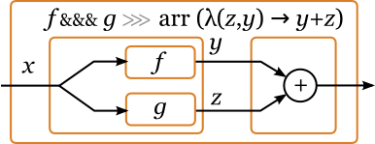
Parallel composition
def combine[X, Y](other: Component[I, X])(combiner: (O, X) => Y): Component[I, Y] = { (src &&& other) >>> Component.create(combiner.tupled) }
def &&&[Y](other: Component[I, Y]): Component[I, (O, Y)] = { Component.create((b: I) => (b, b)) >>> (src *** other) }
def ***[X, Y](other: Component[X, Y]): Component[(I, X), (O, Y)] = {
src.lift((input, downstream) => {
input.map(_._1).subscribe(src)
input.map(_._2).subscribe(other)
src.asObservable.zipWithBuffer(other.asObservable)((_, _)).subscribe(downstream)
downstream += src
downstream += other
})
}

Slide 47
Parallel composition
def combine[X, Y](other: Component[I, X])(combiner: (O, X) => Y): Component[I, Y] = { (src &&& other) >>> Component.create(combiner.tupled) }
def &&&[Y](other: Component[I, Y]): Component[I, (O, Y)] = { Component.create((b: I) => (b, b)) >>> (src *** other) }
def ***[X, Y](other: Component[X, Y]): Component[(I, X), (O, Y)] = {
src.lift((input, downstream) => {
input.map(_._1).subscribe(src)
input.map(_._2).subscribe(other)
src.asObservable.zipWithBuffer(other.asObservable)((_, _)).subscribe(downstream)
downstream += src
downstream += other
})
}

Slide 48
Parallel composition
def combine[X, Y](other: Component[I, X])(combiner: (O, X) => Y): Component[I, Y] = { (src &&& other) >>> Component.create(combiner.tupled) }
def &&&[Y](other: Component[I, Y]): Component[I, (O, Y)] = { Component.create((b: I) => (b, b)) >>> (src *** other) }
def ***[X, Y](other: Component[X, Y]): Component[(I, X), (O, Y)] = {
src.lift((input, downstream) => {
input.map(_._1).subscribe(src)
input.map(_._2).subscribe(other)
src.asObservable.zipWithBuffer(other.asObservable)((_, _)).subscribe(downstream)
downstream += src
downstream += other
})
}
def lift[X, Y](liftFunction: (Observable[X], Observer[_ >: Y]) => Unit): Component[X, Y] = { val result = Component[X, Y](input => Observable.create(liftFunction(input, _))) src += result result } // lift is also used in the actual implementation of compose

Slide 49

First/second
def first[Y]: Component[(I, Y), (O, Y)] = { this *** Component.identity[Y] } def second[Y]: Component[(Y, I), (Y, O)] = { Component.identity[Y] *** src }

Slide 50

Parallel composition (2)
def first[Y]: Component[(I, Y), (O, Y)] = { src.lift((input, downstream) => { val srcOut = src.asObservable val inputOut = input.map(_._2) input.map(_._1).subscribe(src) srcOut.zipWithBuffer(inputOut)((_, _)).subscribe(downstream) downstream += src }) } def second[Y]: Component[(Y, I), (Y, O)] = { Component[(Y, I), (I, Y)](_.swap) >>> src.first >>> Component(_.swap) } def ***[X, Y](other: Component[X, Y]): Component[(I, X), (O, Y)] = { src.first[X] >>> other.second[O] }

Slide 51
Parallel composition (2)
def first[Y]: Component[(I, Y), (O, Y)] = { src.lift((input, downstream) => { val srcOut = src.asObservable val inputOut = input.map(_._2) input.map(_._1).subscribe(src) srcOut.zipWithBuffer(inputOut)((_, _)).subscribe(downstream) downstream += src }) } def second[Y]: Component[(Y, I), (Y, O)] = { Component[(Y, I), (I, Y)](_.swap) >>> src.first >>> Component(_.swap) } def ***[X, Y](other: Component[X, Y]): Component[(I, X), (O, Y)] = { src.first[X] >>> other.second[O] }

Slide 52
Parallel composition (2)
def first[Y]: Component[(I, Y), (O, Y)] = { src.lift((input, downstream) => { val srcOut = src.asObservable val inputOut = input.map(_._2) input.map(_._1).subscribe(src) srcOut.zipWithBuffer(inputOut)((_, _)).subscribe(downstream) downstream += src }) } def second[Y]: Component[(Y, I), (Y, O)] = { Component[(Y, I), (I, Y)](_.swap) >>> src.first >>> Component(_.swap) } def ***[X, Y](other: Component[X, Y]): Component[(I, X), (O, Y)] = { src.first[X] >>> other.second[O] }

Slide 53
Parallel composition (2)
def first[Y]: Component[(I, Y), (O, Y)] = { src.lift((input, downstream) => { val srcOut = src.asObservable val inputOut = input.map(_._2) input.map(_._1).subscribe(src) srcOut.zipWithBuffer(inputOut)((_, _)).subscribe(downstream) downstream += src }) } def second[Y]: Component[(Y, I), (Y, O)] = { Component[(Y, I), (I, Y)](_.swap) >>> src.first >>> Component(_.swap) } def ***[X, Y](other: Component[X, Y]): Component[(I, X), (O, Y)] = { src.first[X] >>> other.second[O] }
Less efficient: two zipWithBuffer operators

Slide 54
Feedback
def feedback(transducer: Component[O, I])(implicit n: Numeric[I]): Component[I, O] = {
import n._
lift((setpoint, downstream) => {
transducer.asObservable
.withLatestFrom(setpoint)((o, s) => s - o)
.observeOn(new TrampolineScheduler)
.subscribe(src)
src += src.asObservable
.publish(source => {
source.subscribe(downstream)
source.subscribe(transducer)
source
}).subscribe()
downstream += src
downstream += transducer
transducer += src
})
}

Slide 55
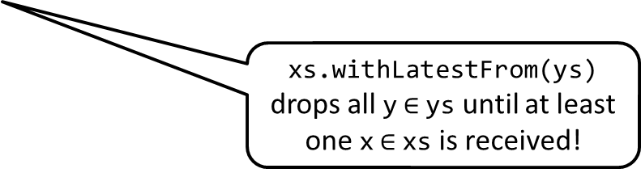
Feedback
def feedback(transducer: Component[O, I])(implicit n: Numeric[I]): Component[I, O] = {
import n._
lift((setpoint, downstream) => {
transducer.asObservable
.withLatestFrom(setpoint)((o, s) => s - o)
.observeOn(new TrampolineScheduler)
.subscribe(src)
src += src.asObservable
.publish(source => {
source.subscribe(downstream)
source.subscribe(transducer)
source
}).subscribe()
downstream += src
downstream += transducer
transducer += src
})
}
xs.withLatestFrom(ys) drops all y$∈$ys until at least one x$∈$xs is received!

Slide 56
Feedback
// Many thanks to @GeorgiKhomeriki for coming up with this function!
def loop(transOut: Observable[I], setpoint: Observable[I])(f: (I, I) => I): Observable[I] = transOut.publish(tos => setpoint.publish(sps => tos.combineLatest(sps)((_, _))
.take(1) .flatMap { case (t, s) => Observable.create[I](observer => { tos.withLatestFrom(sps.startWith(s))(f).subscribe(observer) observer.onNext(f(t, s)) }) }))
def feedback(transducer: Component[O, I])(implicit n: Numeric[I]): Component[I, O] = {
import n._
lift((setpoint, downstream) => {
loop(transducer.asObservable, setpoint)((o, s) => s - o)
.observeOn(new TrampolineScheduler)
.subscribe(src)
// the rest is the same
})
}

Slide 57
Other operators
implicit class RxOperators[I, O](val src: Component[I, O]) { def liftRx[Y](f: Observable[O] => Observable[Y]) = src >>> Component[O, Y](f)
def drop(n: Int): Component[I, O] = liftRx(_.drop(n))
def filter(predicate: O => Boolean): Component[I, O] = liftRx(_.filter(predicate))
def map[X](f: O => X): Component[I, X] = liftRx(_.map(f))
def startWith(o: O): Component[I, O] = liftRx(_.startWith(o))
// and many more! }

Slide 58
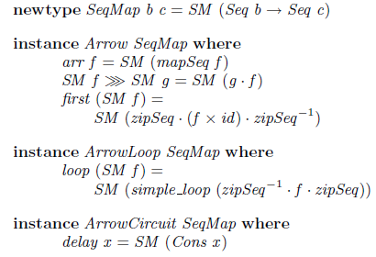



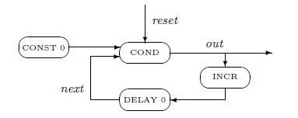
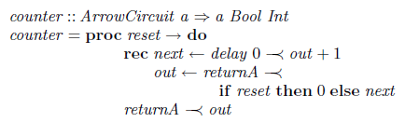
Second implementation
Ross Paterson – “A New Notation for Arrows”

Slide 59
Second implementation
class Component[I, O](transform: Observable[I] => Observable[O]) { def run(is: Observable[I]): Observable[O] = { transform(is) } } object Component { def apply[I, O](transform: Observable[I] => Observable[O]): Component[I, O] = { new Component(transform) } def create[I, O](f: I => O): Component[I, O] = { Component(_ map f) } def identity[T]: Component[T, T] = { Component[T, T](Predef.identity) } }

Slide 60
Arrow operators
implicit class ArrowOperators[I, O](val src: Component[I, O]) { def concat[X](other: Component[O, X]): Component[I, X] =
Component(other.run _ compose src.run) def first[X]: Component[(I, X), (O, X)] = this *** Component.identity[X] def second[X]: Component[(X, I), (X, O)] = Component.identity[X] *** src
def ***[X, Y](other: Component[X, Y]): Component[(I, X), (O, Y)] = { Component(_.publish(ixs => { src.run(ixs.map(_._1)).zipWithBuffer(other.run(ixs.map(_._2)))((_, _)) })) } def &&&[X](other: Component[I, X]): Component[I, (O, X)] = { Component.create[I, (I, I)](a => (a, a)) >>> (src *** other) } def combine[X, Y](other: Component[I, X])(f: (O, X) => Y): Component[I, Y] = { (src &&& other) >>> Component.create(f.tupled) } }

Slide 61
Feedback operators
implicit class FeedbackOperators[I, O](val src: Component[I, O]) {
// loop function is the same as before
def feedbackWith(transducer: Component[O, I])(implicit n: Numeric[I]): Component[I, O] =
Component(setpoint => { val srcIn = Subject[I]()
src.run(srcIn) .publish(out => { loop(transducer.run(out), setpoint)((o, s) => s - o) .observeOn(new TrampolineScheduler) .subscribe(srcIn) out }) }) }
}

Slide 62
A problem with feedback
@Test def testFeedbackIdentity() = { val k = 160
val feedback = Component[Double, Double](_.scanLeft(0.0)(_ + _)) .map(k *) .map(x => math.max(0, math.min(1, x / 100))) .feedback(Component.identity[Double]) val input = Subject[Double]() val testObserver = ListObserver[Double]() feedback.run(input).take(5).subscribe(testObserver) input.onNext(0.6) assertEquals(List(0.0, 0.96, 0.384, 0.7295999999999999, 0.52224), testObserver.values) assertEquals(None, testObserver.error) // assertTrue(input.isUnsubscribed) assertTrue(testObserver.isUnsubscribed) }
The input doesn’t unsubscribe…

Slide 63
Functor / Applicative operators
implicit class ApplicativeOperators[I, O](val src: Component[I, O]) { def map[X](f: O => X): Component[I, X] = { src >>> Component.create(f) } def <*>[X, Y](other: Component[I, X])(implicit ev: O <:< (X => Y)): Component[I, Y] = { src.combine(other)(ev(_)(_)) } def *>[X](other: Component[I, X]): Component[I, X] = { src.map[X => X](_ => identity) <*> other } def <*[X](other: Component[I, X]): Component[I, O] = { src.map[X => O](o => _ => o) <*> other } def <**>[X](other: Component[I, O => X]): Component[I, X] = { other <*> src } }

Slide 64
Monad operator???
// bind operator doesn't make sense according to Hughes (1998)
implicit class MonadOperators[I, O](val src: Component[I, O]) { def flatMap[X](f: O => Component[I, X]): Component[I, X] = { Component(_.publish(is => src.run(is).flatMap(f(_).run(is)))) } }

Slide 65
Monad operator???
// bind operator doesn't make sense according to Hughes (1998)
implicit class MonadOperators[I, O](val src: Component[I, O]) { def flatMap[X](f: O => Component[I, X]): Component[I, X] = { Component(_.publish(is => src.run(is).flatMap(f(_).run(is)))) } }

Slide 66
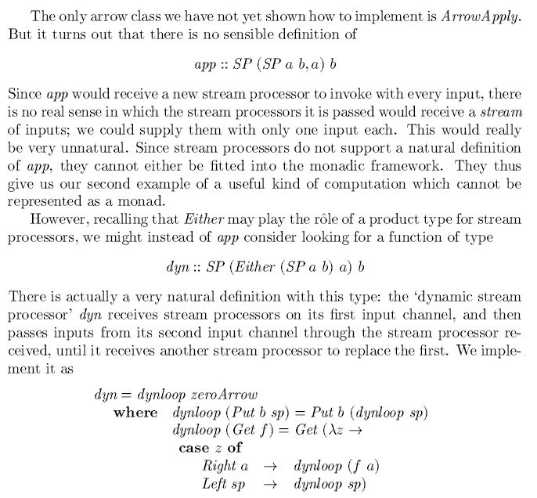
Monad operator???
// bind operator doesn't make sense according to Hughes (1998)
implicit class MonadOperators[I, O](val src: Component[I, O]) { def flatMap[X](f: O => Component[I, X]): Component[I, X] = { Component(_.publish(is => src.run(is).flatMap(f(_).run(is)))) } }

Slide 67
Monad operator???
// bind operator doesn't make sense according to Hughes (1998)
implicit class MonadOperators[I, O](val src: Component[I, O]) { def flatMap[X](f: O => Component[I, X]): Component[I, X] = { Component(_.publish(is => src.run(is).flatMap(f(_).run(is)))) } }
ArrowApply == Monad

Slide 68
Monad operator???
// bind operator doesn't make sense according to Hughes (1998)
implicit class MonadOperators[I, O](val src: Component[I, O]) { def flatMap[X](f: O => Component[I, X]): Component[I, X] = { Component(_.publish(is => src.run(is).flatMap(f(_).run(is)))) } }
ArrowApply == Monad
SP == Component

Slide 69
Monad operator???
// bind operator doesn't make sense according to Hughes (1998)
implicit class MonadOperators[I, O](val src: Component[I, O]) { def flatMap[X](f: O => Component[I, X]): Component[I, X] = { Component(_.publish(is => src.run(is).flatMap(f(_).run(is)))) } }
ArrowApply == Monad
SP == Component
flatMap would receive a new Component for every input value

Slide 70
Monad operator???
// bind operator doesn't make sense according to Hughes (1998)
implicit class MonadOperators[I, O](val src: Component[I, O]) { def flatMap[X](f: O => Component[I, X]): Component[I, X] = { Component(_.publish(is => src.run(is).flatMap(f(_).run(is)))) } }
ArrowApply == Monad
SP == Component
flatMap would receive a new Component for every input value
An alternative to flatMap that seems obvious is switchMap

Slide 71
Feedback API
Two implementations
Based on derivation of Mealy Machine
Based on paper by Ross Paterson
Almost identical interface
Observable.from(inputObs) >>> c1.asObservable
c1.run(inputObs)

